Slide 1

Reference Architecture Solution Demo
Wely Lau
SR Cloud Solution Architect
Microsoft APAC
Notes:
Hey folks, Wely here, I am a CSA in Microsoft APAC.
Today, I am going to start an initiative called Azure Reference Architecture Solution Demo.

Slide 2
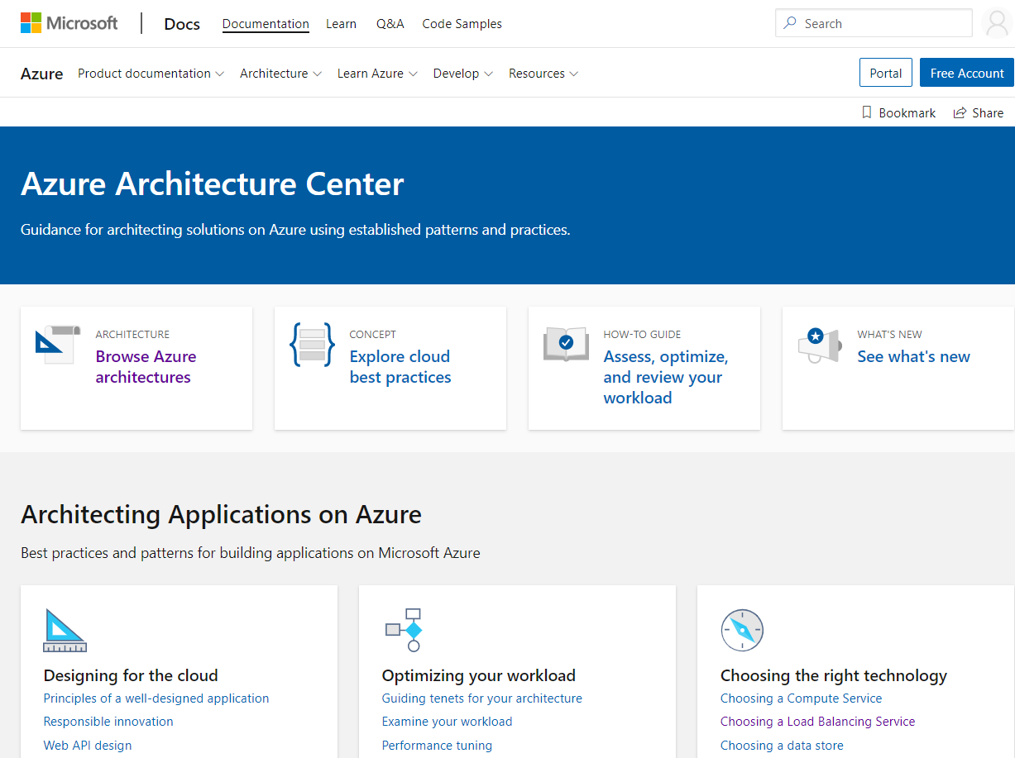
The motivation for this initiative
To enable customers and partners details guidance on how the references architectures could be implemented in real world.
From Azure architecture centers (https://docs.microsoft.com/en-us/azure/architecture/)
Azure services documentation
Principles:
[FEASIBILITY] Implement and refine the reference architectures into workable demos
[REUSABLITY] Provide the deployment template and sample code in GitHub
[CLARITY] Produce the videos to explain how it all works
Notes:
You may be aware that we have many available reference architecture and documentation in Azure . This certainly helps giving idea to some of our customers visualizing how it may look like. However, unless you really implement them, or else you may not be aware about the details, what works, what doesn’t, what are the pros and cons when choosing one architecture over another.
That’s exactly the motivation of this initiative. Implementing and refining the architecture in real actions.
This initiative will be implemented with 3 principles: Firstly it is the feasibility, which we will ensure that the architectures are indeed feasible in the implementation. In many cases, we will refine and improve them.
Secondly, it is about the reusability. We make the demo template and sample code available in GitHub so that you can easily deploy them by your own.
Lastly, it is about clarity. We will produce multiple videos starting from crash course of each services and tools used in demo all the way to the actual demos in action.

Slide 3






Series 1: Multi-region deployment & disaster recovery on Azure
App Service SQL Database Traffic Manager
Wely Lau
SR Cloud Solution Architect
Microsoft Asia Pacific
Adityo Setyonugroho
Cloud Solution Architect
Microsoft Indonesia
Notes:
With that, let’s start the first series: about Multi-region deployment and DR on Azure. This is one of the commonly asked topic, especially when the customer has mission critical apps which can’t afford much downtime.
Joining me in this series Adityo from Microsoft Indonesia. He has been awesome, helping me to develop some of the demo.
Throughout the demo, we will be primarily using App Service, SQL DB, and Traffic Manager.
Without further due, let’s get started with the background:

Slide 4
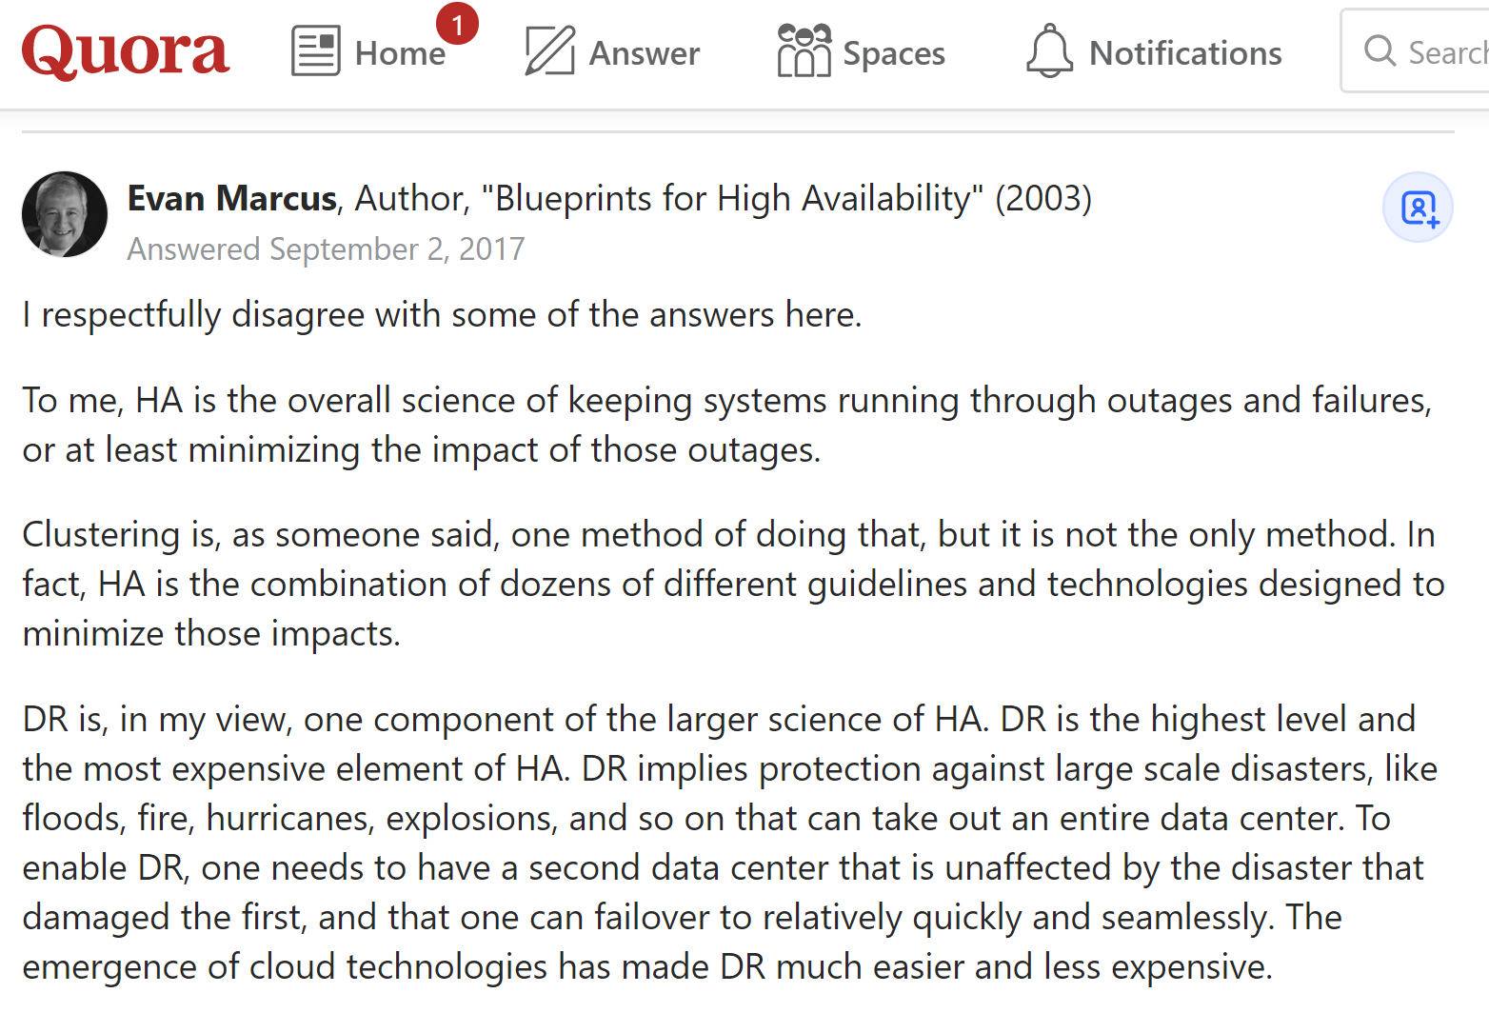
Background: Implementing HA vs DR in the cloud
Many PaaS services such as App Service (Web App) and SQL Database have built-in HA capability within the same region.
With minimal or NO additional configuration
However, it may not be sufficient to response to business in the case of a regional disasters happens.
For mission critical apps, many customers expressed concern about single region deployment.
However, multi-region architecture / deployment are very complex.
Consideration: Application dependency, sync DB, Failover App and DB, etc.
https://www.quora.com/What-is-the-difference-between-Disaster-Recovery-and-High-Availability
Notes:
HA which stands for high availability and DR which stands for Disaster Recovery, two of the terms which are often interchangeably used.
To make sure that we have common understanding, let’s firstly align on the definite. I’m going to use a quote here from Quora by Evan Marcus, stated that:
HA is overall science of keeping system running through outage and failures
While DR is a subset of HA, which is also the most expensive element of HA. It often implies the protection and recovery process over large scale disaster.
Coming to the Azure world, many of the PaaS services like App Service and SQL Database provide built-in HA capability within the region where they are deployed. This in fact, it could be achieved with minimal or even NO additional configuration.
However, it may not able to tolerate large scale disasters which could bring down entire region. This is where you need to plan your multi-region DR strategy carefully: including to add redundancy across another region. Unfortunately, multi-region deployment is rather a complicated architecture. You need to consider things such as database synchronization, failing over the app and database.

Slide 5
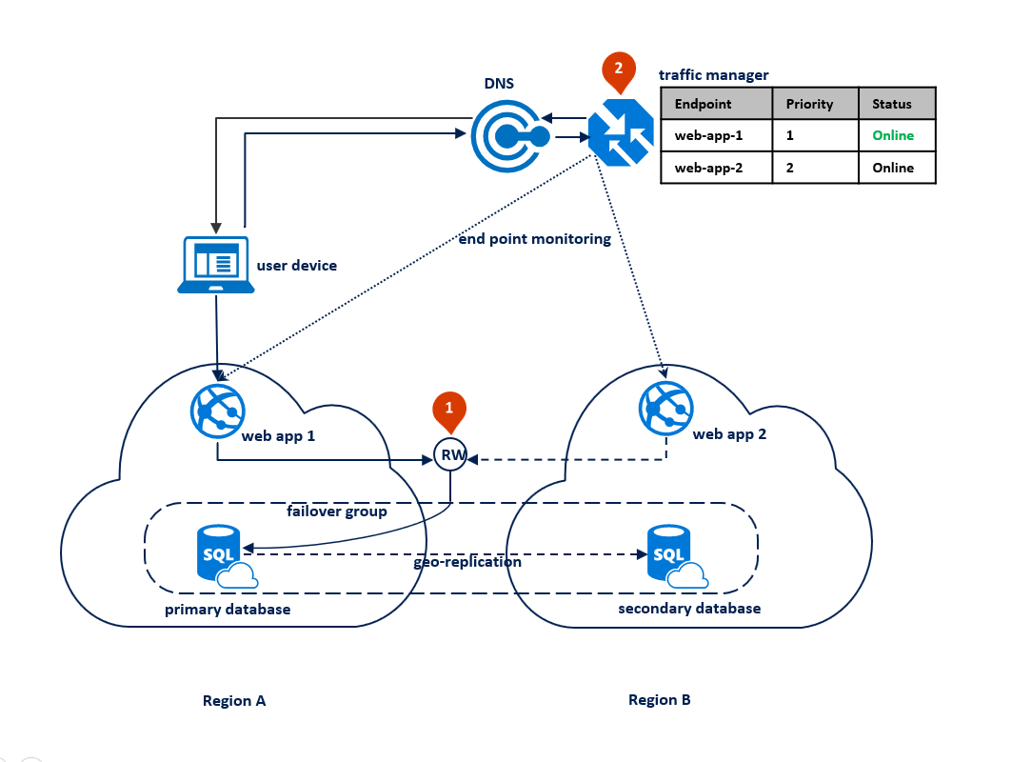
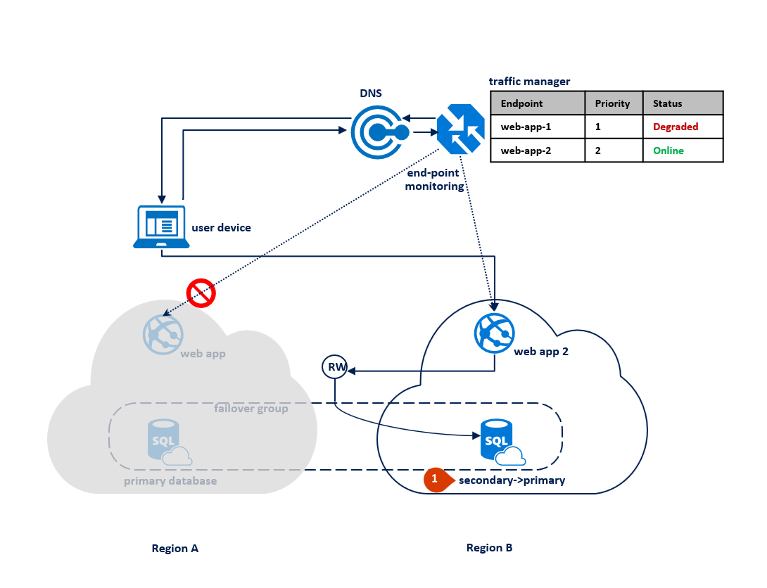
About this demo
Designing globally available services using Azure SQL Database
(Scenario 1: Using two Azure regions for business continuity with minimal downtime)
There are other variation as well
This demo uses Azure App Service (Web App) but it in fact applies to other services including AKS, VM, etc.
It use SQL Database (relational database). The architecture and failover design for NoSQL acts differently.
Other similar architectures:
Run a web application in multiple Azure regions for high availability https://docs.microsoft.com/en-us/azure/architecture/reference-architectures/app-service-web-app/multi-region
https://docs.microsoft.com/en-us/azure/sql-database/sql-database-designing-cloud-solutions-for-disaster-recovery
Notes:
The good news is we have such reference architecture already available if you are using Azure SQL Database. Documentation can be found on the link below.
This is an active passive architecture.
Here is how it works at high level.
There will be a web app accessing a SQL Database deployed on Region A (or we could call it primary region)
The same deployment is deployed on Region B (or secondary region)
On the database level:
In order to ensure the data synchronization and failover capability on the backend database, we make use of SQL Failover Group, which also provides us the Failover Group database endpoint
Both application will access the database with the Failover Group DB endpoint.
On the application level
Both webapp URLs will be registered as endpoints to the Traffic Manager.
Client or browser can then access the Traffic Manager URL.
Since we have set the load balancing method to priority, the TM will route all the request to Web A since it’s on the priority 1 and it’s online
Only if priority 1 is down, the traffic will be subsequently redirect to the subsequent priority, in this case Web B
The app can failover easily thanks to the Traffic Manager, however it’s not as straightforward for the database.
In the upcoming videos, I will explain this further in more details.

Slide 6
End of the section
Coming up next: Crash course on various azure services
Notes:
This is the end of the video. I will see you in the next one where we will spend few minutes walking through some Azure services and tools used in this demo. Thanks for watching.

Slide 7






Video 2: Crash Course into services & tools for demo
App Service SQL Database Traffic Manager
EventHub Stream Analytic Azure Function Logic Apps
Wely Lau
Sr Cloud Solution Architect
Microsoft APAC
Notes:
Hey folks, Wely speaking. Welcome to the second video of this series. In this video, I am going to provide a crash course on some of the Azure services as well as tools used in this video. The core idea of a crash course is to provide you some fundamental idea of what each services are and the basic usage scenario. You will also find a link on each service so that you can learn more.
However, for those of you who are already familiar with the logos shown above, feel free to skip this crash course. You can move on to the next one.

Slide 8


















Azure App Service (Web App)
DevOps productivity
Source code control integration
CI/CD build and deploy
Staged
deployments with slots
Auto scale on demand
Monitoring and alerting
Application templates
PaaS compute platform to host web or api
Extremely easy to get started
Windows or Linux Worker
{ Bring your own } Code OR Container
Rich feature-sets
Umbraco
Orchard
Episerver
WordPress
DNN Platform
Joomla
Drupal
Multiple languages and frameworks
Enterprise workloads
Industry standards
Global scale
Corporate connectivity
Azure Active Directory
Dedicated environments
Learn More @ https://azure.microsoft.com/en-us/services/app-service/
Notes:
The first Azure service we’ll be discussing is Azure App Service, also know as Web App. It’s a PaaS compute platform that enables you to host web or api. One of the value proposition of App Service is the fact that it’s very easy to get started, with very low learning curve.
You can provision App Service by choosing Windows or Linux worker.
You can then decide if you want to bring your code and then run one of the pre-built image. Or simply bring your docker container by referencing it to your container registry.
App Services comes with a lots of devops productivity features such as deployment slot, auto-scale, and integration with Azure DevOps or GitHub.
In addition to bring your own code, you may also choose the app from Application Templates, which you could find many of the popular application, blogs, and CMS.
App Services supports multiple programming languages, such as .NET, Java, Python, Node, and so many more.
We will host our api on App Service for the demo.

Slide 9



Azure sql database
(Platform-Managed database based on SQL Server Engine)
Learns & adapts
Scales on the fly
Enables multi- tenant SaaS apps
Works in your environment
Secures & protects
Realize automatic performance improvements from continuous assessments
Change service tiers, performance levels, and storage dynamically with minimal downtime.
Easily manage and monitor multitenant apps, and benefit from database isolation
Develop your app and connect to SQL Database with the tools and platforms you prefer
Build security-enhanced, highly compliant apps with built-in protection and intelligent Threat Detection
High availability features
Automatic backups
Point in time restore with up to 35 days retention
Active Geo-Replication & Failover Groups
Other Open Source DB variation
Azure Database for MySQL, MariaDB, PostgreSQL
Learn More @ https://azure.microsoft.com/en-us/services/sql-database/
Notes:
Let’s move on to the next one, Azure SQL DB. It’s a PaaS relational database, running on SQL Server engine.
It comes with many pre-built features such as starting from automatic performance improvement and recommendation, on the fly scaling, and built-in threat detection.
Azure SQL DB also can work with existing tool such as SQL Management Studio which many of you are already familiar with.
It also comes with great HA features such as auto-backup and point in time restore. You can also leverage Active Geo-Replication and Failover Group for databases across different regions for DR purpose.
In our demo, we will be using Failover Group to demonstrate the database failover.
In addition to the SQL Server engine, Azure has other variation PaaS open source databases, namely Azure DB for MySQL, MariaDB, and PostgreSQL.

Slide 10

Azure Traffic Manager
Azure Traffic Manager is a DNS-based traffic load balancer that enables you to distribute traffic optimally to services across global Azure regions, while providing high availability and responsiveness.
Works with endpoints:
Cloud Service (web / worker roles), App Service (Web App and slots), public IP address
You define the configuration including DNS TTL, Protocols (HTTP, HTTPS, TCP), Port, Probing interval, tolerated number of failures.
Load Balancing (traffic routing) methods for different scenarios:
Priority: disaster recovery and failover
Weighted: global level load balancing
Performance: global outreach based on performance
Geographic
Multi-value
Subnet
99.99% availability SLA
Priority Routing Method
Learn More @ https://docs.microsoft.com/en-us/azure/traffic-manager/traffic-manager-overview
Notes:
The next service is Azure TM.
TM is global-dns traffic load balancer, which enables you to distribute the traffic globally.
Not only it works with Azure services such as cloud service and app Services, it also work with any public ip address or public domain.
So, here’re how it works:
Firstly you create a TM profile by defining the endpoint name, which will eventually become your domain
You then register endpoints of your apps (either in form of ip address or domain name) to the TM
Subsequently you define the LB or traffic routing method. We have 6 methods today. Each of them can be used to solve different scenario.
We will be using Priority in this demo.
You also need to define other settings such as:
port, we support http, https, or tcp;
Another important setting is probing interval which determines how frequent do you want the traffic manager to check your application’s heartbeat.
Finally about tolerated number of failures, which determines how many time do you tolerated the failure to invoke the endpoint failover
One notable thing about TM is the 4 nine SLA, which is higher than other Azure services.

Slide 11
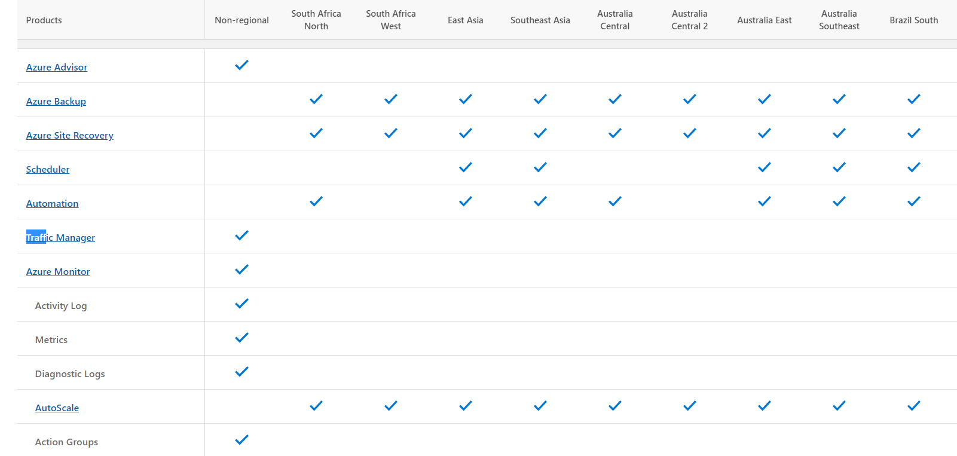
Azure Traffic Manager is a global / non-regional service
Learn More @ https://docs.microsoft.com/en-us/azure/traffic-manager/traffic-manager-overview
Notes:
One of the reason why it has much higher SLA is the fact that TM is a global or non-regional service.
Unlike, typical Azure services, you don’t need to specify the region / data center location during the provisioning of the TM profile.
This is because TM will in fact be deployed globally into multiple regions.

Slide 12

Azure Event Hubs
Azure Event Hubs is a fully managed, highly scalable real-time data ingestion service.
It’s often used in a big data pipeline
Stream millions of events per second from any source to build dynamic data pipelines.
Ingest data from anywhere and develop across platforms with support for popular protocols, including AMQP, HTTPS, and Apache Kafka.
Built-in integration (both event publishers and consumers) with various Azure services
Learn More @ https://azure.microsoft.com/en-us/services/event-hubs/
Notes:
Let’s switch our gear to Azure Event Hubs.
Think about Event Hubs as a highly scalable real-time data ingestion service, which allows you to stream millions of events per second.
It’s often used in big data pipelines.
It supports popular protocols such as AMQP, HTTPS, or Apache Kafka.
To use Event Hubs, you first need to connect to the event publishers. This could be any devices with the supported protocol or other Azure services.
You can then dispatch those events into different event consumers, which could be a custom service or Azure services such as Stream Analytics which we will be discussing next.

Slide 13
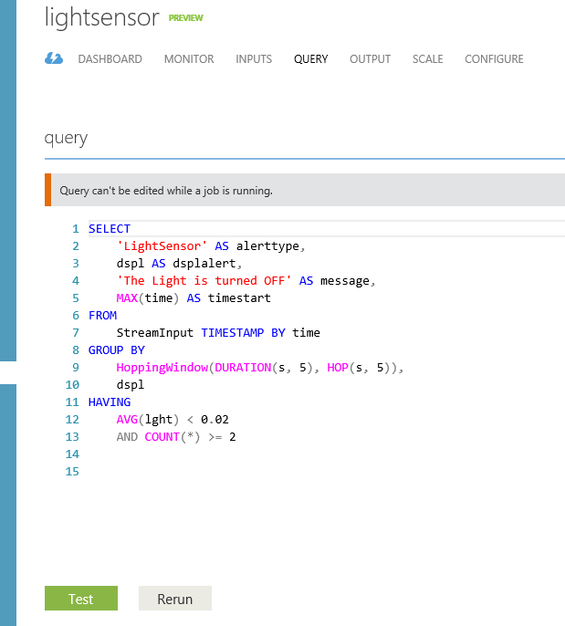


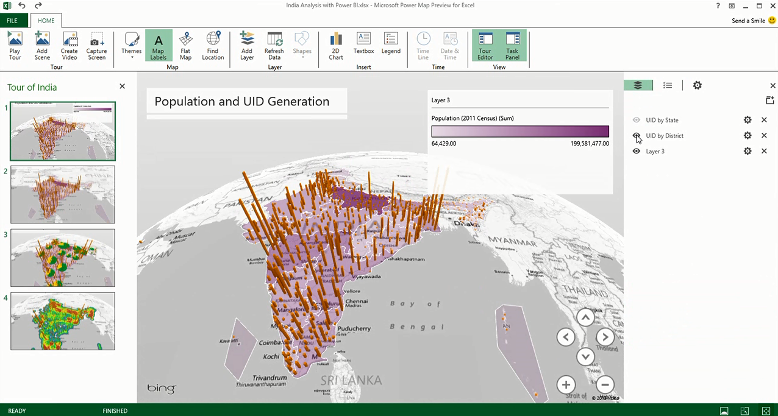
Azure Stream Analytics
Consumes millions of real-time row data, messages, events from Event Hub collected from devices, sensors, infrastructure, and applications
Performs time-sensitive analysis using SQL-like language against multiple real-time streams and reference data
Outputs to persistent stores, dashboards or back to devices
Smart Phones
Specialized Devices
Servers
ATM
Security
POS Terminals
Stream Analytics
PCs/ Laptops
Automation Devices
Digital Signs
Thin Clients
Kiosks
Vending Machines
Diagnostic Equipment
Point of Service Devices
Logic Controllers
Remote Medical Monitors
Learn More @ https://docs.microsoft.com/en-us/azure/stream-analytics/stream-analytics-introduction
Notes:
Typical messages or events sent from devices are in rather raw format. We need to further process or analyze them to make them into more meaningful information. This is where Stream Analytics can help us perform the analysis with SQL-like query in Realtime.
We can then push the processed data to data store such as Cosmos DB, SQL Database, or Power Bi. We can also invoke Azure Function directly just like what we’ll be doing in our demo.

Slide 14

What is Azure Functions? An event-based, serverless compute experience that accelerates app development
Integrated programming model
Use built-in triggers and bindings to define when a function is invoked and to what data it connects
Enhanced development experience
Code, test and debug locally using your preferred editor or the easy-to-use web-based interface including monitoring
Hosting options flexibility
Choose the deployment model that better fits your business needs without compromising development experience
Learn More @ https://azure.microsoft.com/en-us/services/functions/
Notes:
Azure Functions is serverless compute, which enables developers to write and run app or api in a very rapid way.
It has integrated programing model so-called triggers and bindings, which simplify the way we program, especially interacting with other services.
You can develop Azure Functions locally with your preferred editor such as VS Code or Visual Studio. Or you may also use web-based interface for light editing experience.
Azure Functions is a fully open source project, you can find the runtime, sample code, sdk, etc on GitHub.
Not only you can run Azure Functions on Azure, you can also run it on your local machine or any other environment.

Slide 15
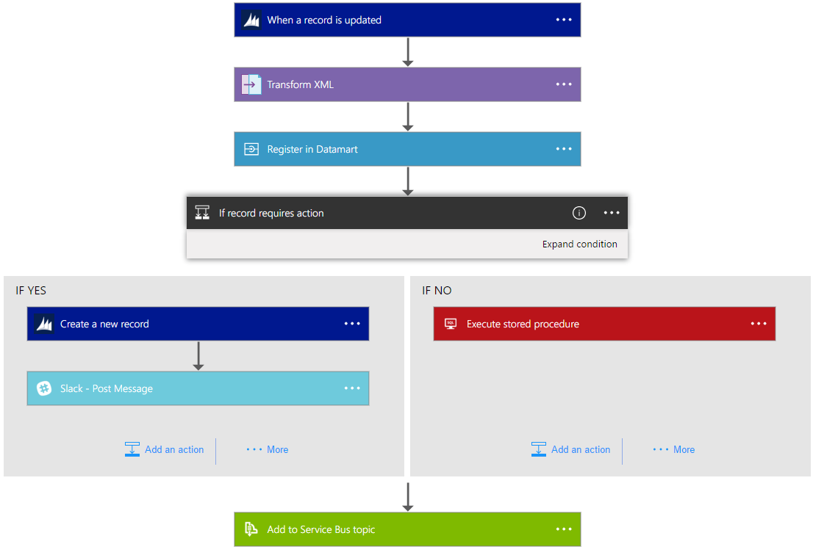
Azure Logic Apps
Automate workflows and orchestrate business processes easily
More than 200 connectors reduce integration challenges
Connect and integrate data from the cloud to on-premises
B2B and enterprise messaging in the cloud
Powerful web-based workflow designer
Learn More @ https://docs.microsoft.com/en-us/azure/logic-apps/
Notes:
Moving on, we’ll discuss about Azure Logic Apps. While Azure Function is serverless platform for executing your codes, think about Logic Apps as serverless platform for running workflow.
It allows you to design business process workflow with a UI designer, from Visual Studio or directly on the Azure Portal.
You could build workflow for scenario such as cloud to on-premise integration, business to business data exchanges, or business to social media workflow.
It comes with more than 200 connectors that allows you to design your workflow efficiently. And we are constantly adding more and more connectors.

Slide 16
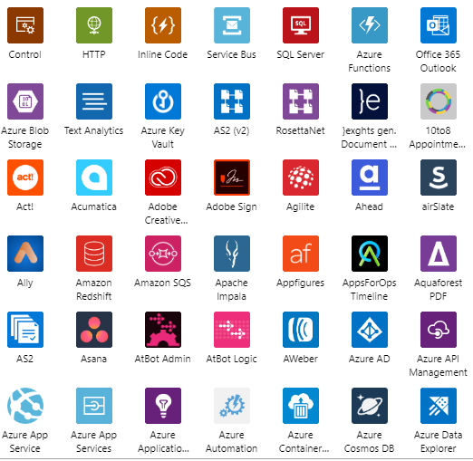
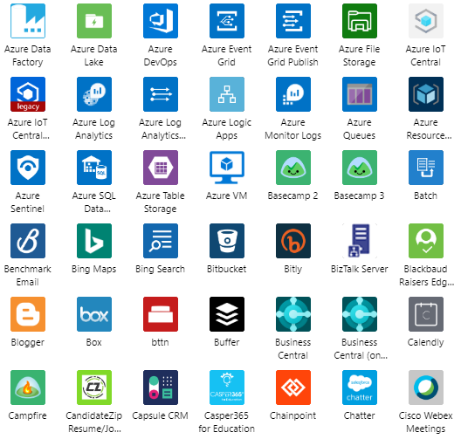
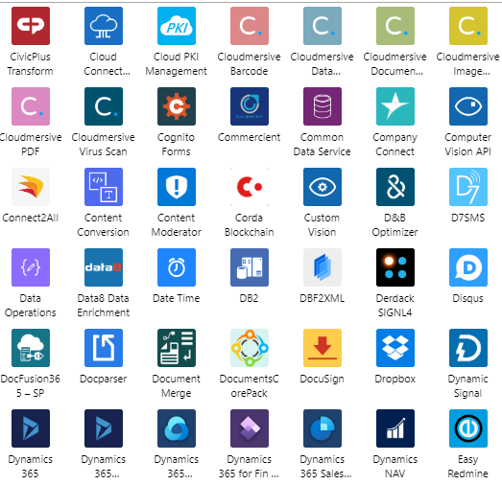
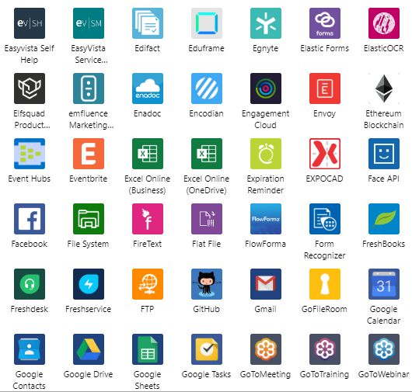
Learn More @ https://docs.microsoft.com/en-us/connectors/connector-reference/connector-reference-microsoft-connectors
Notes:
Here are just some of the connectors that you can leverage to design your workflow.
As can be seen, we have several connectors from Azure services including Event Hubs, Event Grids, and Log Analytics.
We also have many connectors from broader Microsoft services such as Office 365 Outlook, Cognitive Services, and Teams.
Not only just supporting Microsoft services, we also have connectors which connects to 3rd party services such as Facebook, Twitter, EventBrite, Docusign, and so many more.
If you can’t find the connectors you need, you could either built your own connector or simply leverage common connector such as HTTP connector.

Slide 17
Client tools
Postman is a collaboration platform for API development.
Quickly and easily send REST, SOAP, and GraphQL requests directly within Postman.
Learn more at https://www.postman.com/
The Apache JMeter is open source software, a 100% pure Java application designed to load test functional behavior and measure performance.
It was originally designed for testing Web Applications but has since expanded to other test functions.
Learn more at https://jmeter.apache.org/
Notes:
In addition to Azure services, we will be also using two client tools during the demo.
The first one is postman, a very handy and popular tool that enables us to send and inspect http request.
Postman can be installed on multiple platform including Windows, Linux, and Mac.
Another tool that we’ll be using is Apache Jmeter, an open source software built on Java, which usually used to perform load tests.
It comes with very flexible and rich configuration options to construct the load testing preference.
I will install it on an Azure VM.
In our scenario, we are not using it for load testing, but rather periodically making request to check the availability of our app.

Slide 18
End of the section
Coming up next: the sample app
Notes:
That’s all for the second video. Thanks so much for watching. I’ll see you in the next one.

Slide 19
Video 3: Sample App and deployment on Azure
Wely Lau
Sr Cloud Solution Architect
Microsoft APAC

Slide 20
Demo: database and resources in Azure
Get Order, Add Order, Connection String
Response Header: Web-REGION-NAME & DB-Server-NAME, TOTAL-RECORD
Notes:
Start from DB in each Resource Group;
Show fa
Database:
Table Order

Slide 21
Demo: app, api and resources in Azure
Get Order, Add Order, Connection String
Response Header: Web-REGION-NAME & DB-Server-NAME, TOTAL-RECORD
Notes:
Start from DB in each Resource Group;
Show fa
Database:
Table Order

Slide 22
End of the section
Coming up next:
- Scenario 1 (ALL Service Running WELL)
- scenario 2 (Web A is down)

Slide 23
Video 4: Scenario 1 (All running fine) Scenario 2 (Web A is down)
Wely Lau
Sr Cloud Solution Architect
Microsoft APAC

Slide 24

Scenario 1: All working as expected
http://rasd.trafficmanager.net
Bind to my custom domain (http://tm.wely-lau.net)
LB Method: Priority
Client
Traffic Manager will only route the traffic to Web A
Web A thru Failover Group Endpoint (group.database.windows.net) will access DB A (Read/Write)
Remarks:
Web B is up and running but no traffic will be routed since Priority 1 is online
DB B is up and running but only accessible in Read Only access.
Endpoint | Priority | Status
http://rasdsea.azurewebsites.net | 1 | Online
http://rasdeus.azurewebsites.net | 2 | Online
Web A: rasdsea.azurewebsites.net
DB A: rasdeus.database.windows.net
Region A: Southeast Asia
Web B:
rasdeus.azurewebsites.net
DB B:
rasdeus.database.windows.net
Region B: East US
Failover Group Endpoint:
Read Write: group.database.windows.net
Read: group.secondary.database.windows.net
Notes:
Demo steps A setup:
Showing the setup of the rg, web app,
Explain sql azure failovergroup and endpoints
Explain traffic manager priority and configuration
Showing the setup of the app from VS, connection string, api which returns the header of region
Demo steps B, making first call:
Postman to send post request (add product) to tm endpoint, observe the return header (primary should be SEA)
Demo steps C, database level
SQL Mgt Studio to connect to group endpoint: show primary to read/write; secondary to read only;
Show that you can still connect with direct endpoint;

Slide 25
Demo: Scenario 1
All working as expected
Notes:
Demo steps A setup:
Showing the setup of the rg, web app,
Explain sql azure failovergroup and endpoints
Explain traffic manager priority and configuration
Showing the setup of the app from VS, connection string, api which returns the header of region
Demo steps B, making first call:
Postman to send post request (add product) to tm endpoint, observe the return header (primary should be SEA)
Demo steps C, database level
SQL Mgt Studio to connect to group endpoint: show primary to read/write; secondary to read only;
Show that you can still connect with direct endpoint;

Slide 26
Scenario 2: Web A is down
http://rasd.trafficmanager.net
Bind to my custom domain (http://tm.wely-lau.net)
LB Method: Priority
Client
Web A is suddenly down.
After some time (interval x tolerated no of failure), Traffic Manager will stop routing the traffic to Web A.
It then looks for the subsequent priority (which is 2, Web B)
Because the DB is still working fine, with the same Failover Group Endpoint, Web B will access DB A (Read/Write)
Endpoint | Priority | Status
http://rasdsea.azurewebsites.net | 1 | Online
http://rasdeus.azurewebsites.net | 2 | Online
Web A: rasdsea.azurewebsites.net
DB A: rasdeus.database.windows.net
Region A: Southeast Asia
Web B:
rasdeus.azurewebsites.net
DB B:
rasdeus.database.windows.net
Region B: East US
Failover Group Endpoint:
Read Write: group.database.windows.net
Read: group.secondary.database.windows.net
Notes:
Demo steps:
Explain what we’re going to do next, simulate Web A down
On Azure portal, first make sure that postman accessing TM is up and running
Open Jmeter in the VM, show how we configure Jmeter with 1 second delay
Run Jmeter (
Stop Web A
Show Jmeter with some fail records, observe timeline
(optional) Access TM endpoint with another browser
Wait till Jmeter recover but accessing East US

Slide 27
Demo: Scenario 2
Web A is down
Notes:
Demo steps:
Explain what we’re going to do next, simulate Web A down
On Azure portal, first make sure that postman accessing TM is up and running
Open Jmeter in the VM, show how we configure Jmeter with 1 second delay
Run Jmeter (
Stop Web A
Show Jmeter with some fail records, observe timeline
(optional) Access TM endpoint with another browser
Wait till Jmeter recover but accessing East US

Slide 28
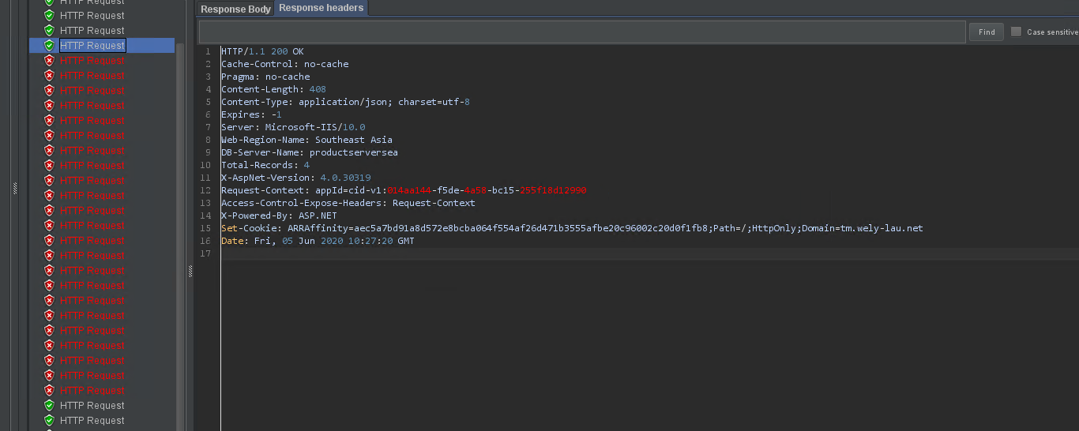
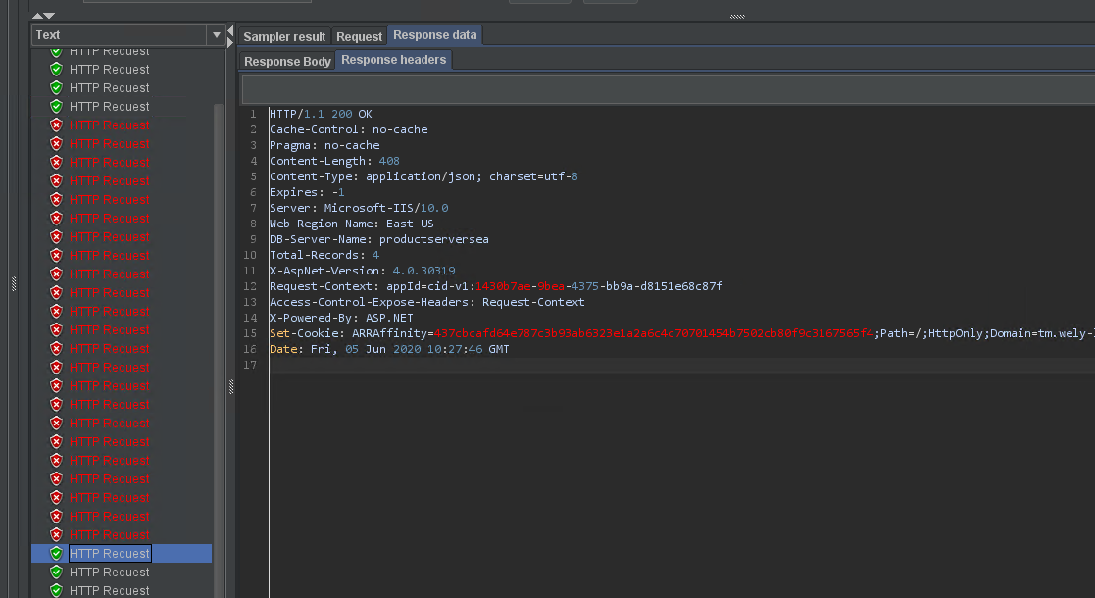
GET ORDERS (GET) 10:27:20 => 10:27:46 = 26 sec
About 26 seconds recovery time

Slide 29
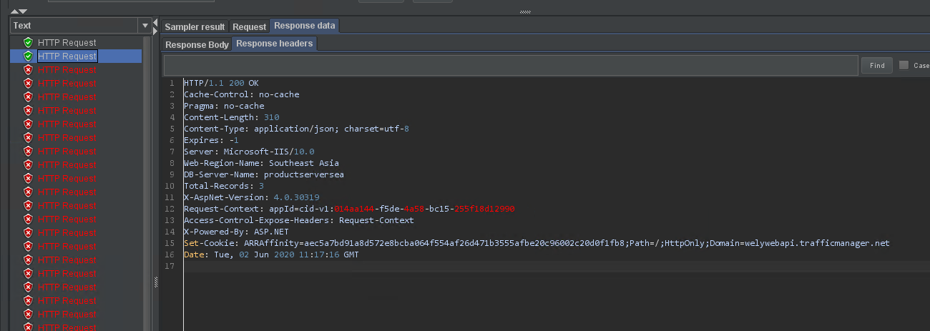
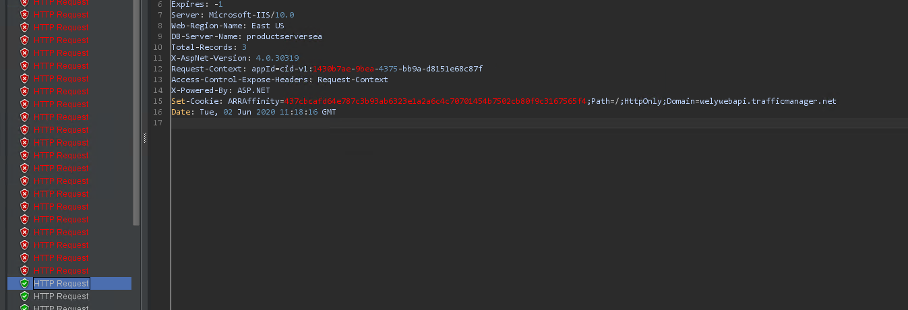
GET ORDERS (GET) 11:17:16 => 11:18:16 = 1 mins
About 1 minute recovery time

Slide 30
End of the section
Coming up next: scenario 3 (DB A is down)

Slide 31
Video 5: Database in Region A is down
Wely Lau
Sr Cloud Solution Architect
Microsoft APAC

Slide 32
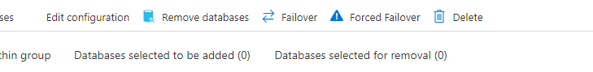
SQL Database Failover Group
Manual Failover:
Failover
Generally used in drill or planned failover, performs full sync between primary and secondary before the failover takes place.
This guarantees no data loss. However, it may take a longer time to complete.
Forced Failover
Immediately switches the secondary to the primary role with the objective of bringing the database up as fast as possible in the secondary region.
As such, it may incur data loss.
Automatic Failover?
Automatic failover will only be initiate by Azure service / engineering team
At the moment, there’s no way to simulate the automatic failover
However, we could design a solution which to automatically trigger the manual failover. This will be discussed by next scenario.

Slide 33
Scenario 3: DB A is down

Slide 34
Scenario 3: DB A is down
http://rasd.trafficmanager.net
Bind to my custom domain (http://tm.wely-lau.net)
LB Method: Priority
Client
DB A is down.
We perform the failover / forced failed over on Azure SQL Failover Group, which promotes secondary database DB B into primary (Read Write).
Failover group endpoint remain unchanged, as such Web A is still be able to access the database without any change of connection string nor redeployment.
Endpoint | Priority | Status
http://rasdsea.azurewebsites.net | 1 | Online
http://rasdeus.azurewebsites.net | 2 | Online
Web A: rasdsea.azurewebsites.net
DB A: rasdeus.database.windows.net
Region A: Southeast Asia
Web B:
rasdeus.azurewebsites.net
DB B:
rasdeus.database.windows.net
Region B: East US
Failover Group Endpoint:
Read Write: group.database.windows.net
Read: group.secondary.database.windows.net
Notes:
Demo steps:
Go to Azure portal, sql failover group
Start JMeter
Perform Failover on the portal
Checkout the downtime

Slide 35
Demo: Scenario 3
Database A is down; Failover Automatically vs manually
Notes:
Demo steps:
Go to Azure portal, sql failover group
Start JMeter
Perform Failover on the portal
Checkout the downtime

Slide 36
End of the section
Coming up next: scenario 4 (entire region A is down)

Slide 37
Video 6: setup for Scenario 4
Wely Lau
Sr Cloud Solution Architect
Microsoft APAC

Slide 38
Scenario 4: Entire region A is down

Slide 39
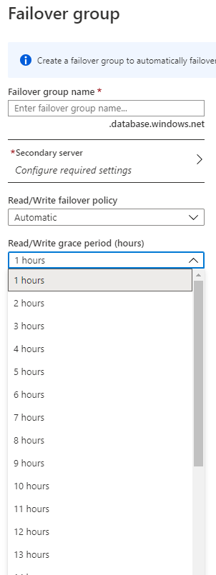
Fine-tuning the original architecture
“Because verification of the scale of the outage and how quickly it can be mitigated involves human actions by the operations team, the grace period cannot be set below one hour. This limitation applies to all databases in the failover group regardless of their data synchronization state.”
https://docs.microsoft.com/en-us/azure/azure-sql/database/auto-failover-group-overview?tabs=azure-powershell
“After an outage in the primary region, the SQL Database service detects that the primary database is not accessible and triggers failover to the secondary region based on the parameters of the automatic failover policy (1). Depending on your application SLA, you can configure a grace period that controls the time between the detection of the outage and the failover itself.” https://docs.microsoft.com/en-us/azure/sql-database/sql-database-designing-cloud-solutions-for-disaster-recovery
Notes:
DB Failover is a big thing. The general guideline is to do it mindfully (typically manually triggered by admin).

Slide 40
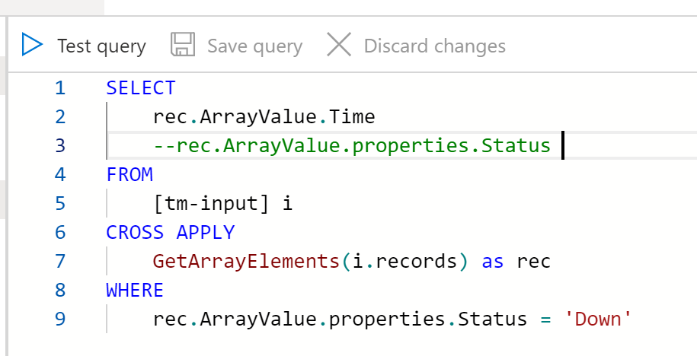
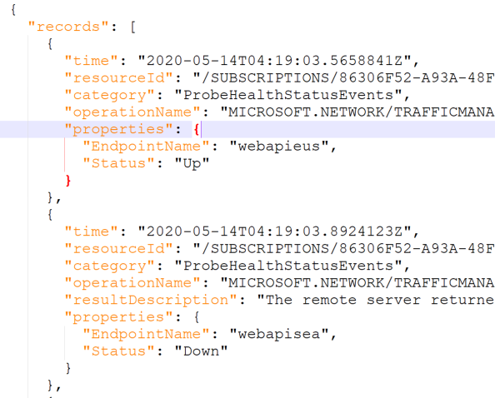
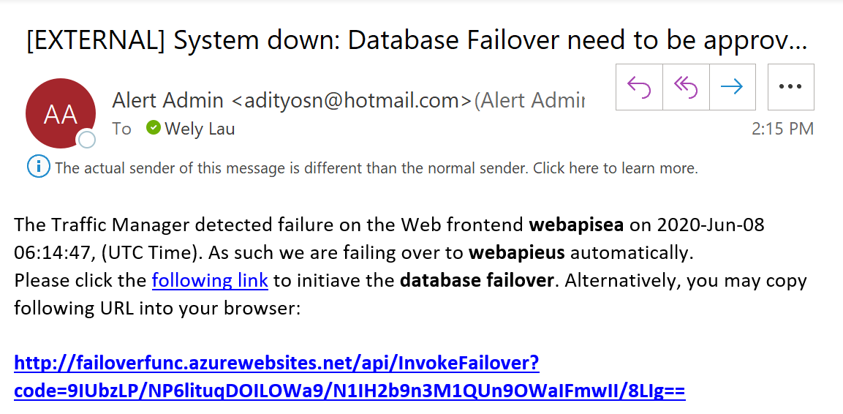
Raising database failover when the primary endpoint in Traffic Manager is detected down
Yes
InvokeFailover
FullAutomated
Failover
Real-time analytic / query with Stream Analytics
Traffic Manager emits diagnostic logs
AlertFailoverAction
No
Ingest with Event Hubs in near-real-time
SendEmail

Slide 41
Video 7: actual demo of Scenario 4

Slide 42
Scenario 4.1: Region A is down (Auto Failover)
http://rasd.trafficmanager.net
Bind to my custom domain (http://tm.wely-lau.net)
LB Method: Priority
Entire region A is down (including Web A and DB A)
TM will route all the traffic to Web B.
Because DB A is also down, we need to trigger the failover of the database to DB B.
TM allows us to emit a set of diagnostic log to EventHub, including the status of the endpoint which we’d need here.
We then use Stream Analytic to query the log containing Status = “Down” and then invoke an Azure Function to perform Database Failover
Client
Endpoint | Priority | Status
http://rasdsea.azurewebsites.net | 1 | Online
http://rasdeus.azurewebsites.net | 2 | Online
Web A: rasdsea.azurewebsites.net
DB A: rasdeus.database.windows.net
Region A: Southeast Asia
Web B:
rasdeus.azurewebsites.net
DB B:
rasdeus.database.windows.net
Region B: East US
Failover Group Endpoint:
Database Failover
Read Write: group.database.windows.net
Read: group.secondary.database.windows.net

Slide 43
Demo: Scenario 4.1
Entire region A is down; FullAutomatedFailover
Notes:
Demo steps:
Go to Azure portal, sql failover group
Start JMeter
Perform Failover on the portal
Checkout the downtime

Slide 44
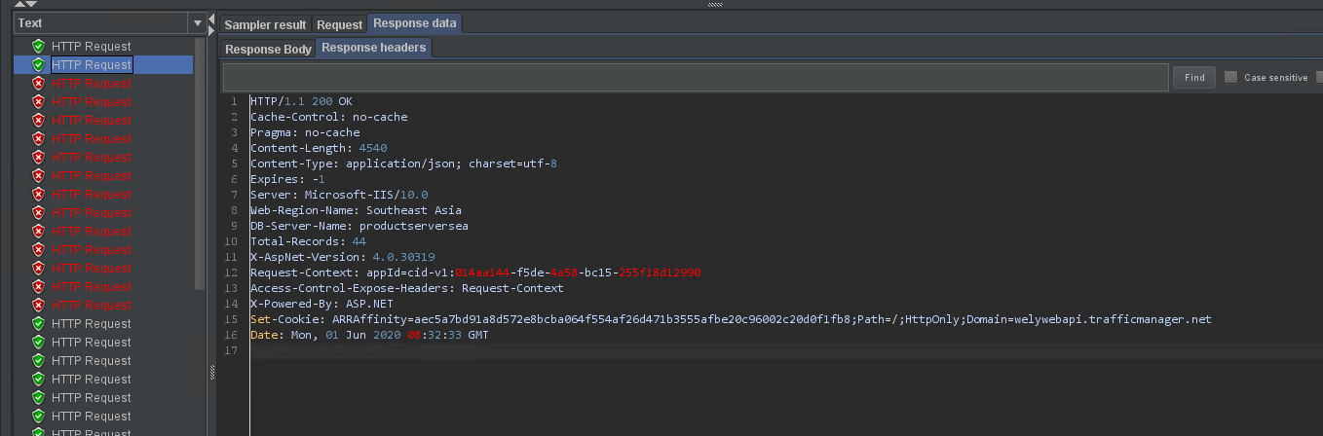
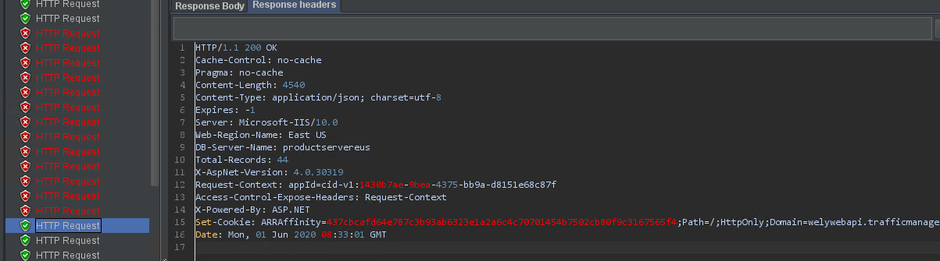
GET ORDERS (GET) 08:32:33 => 08:33:01 = about 1.5 mins
About 1.5 minutes recovery time

Slide 45
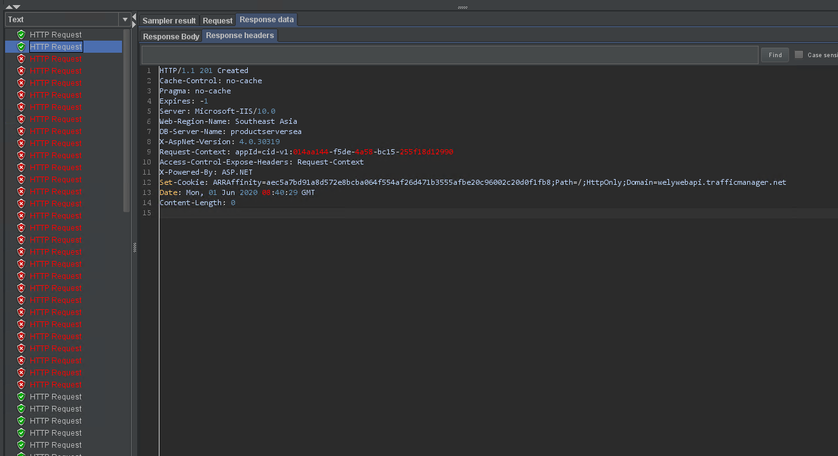
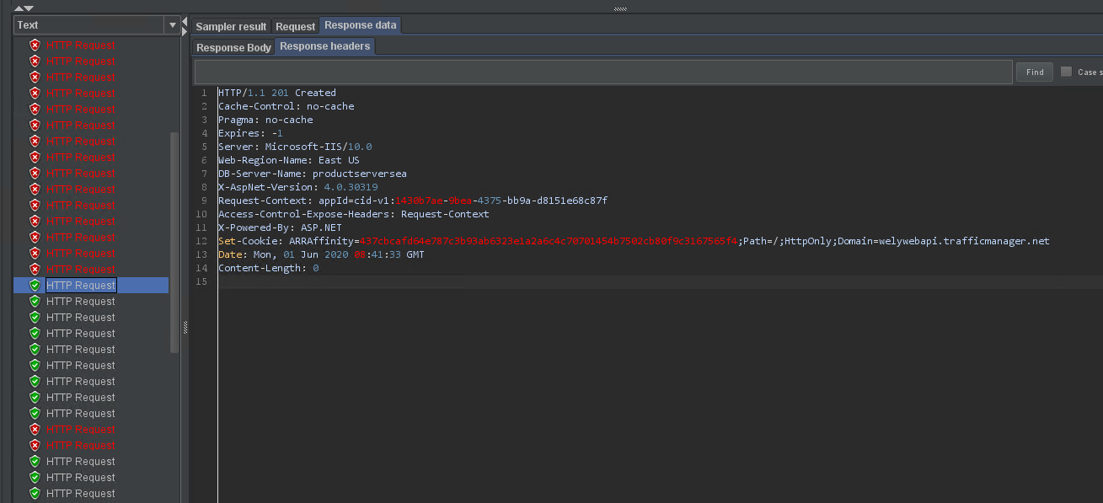
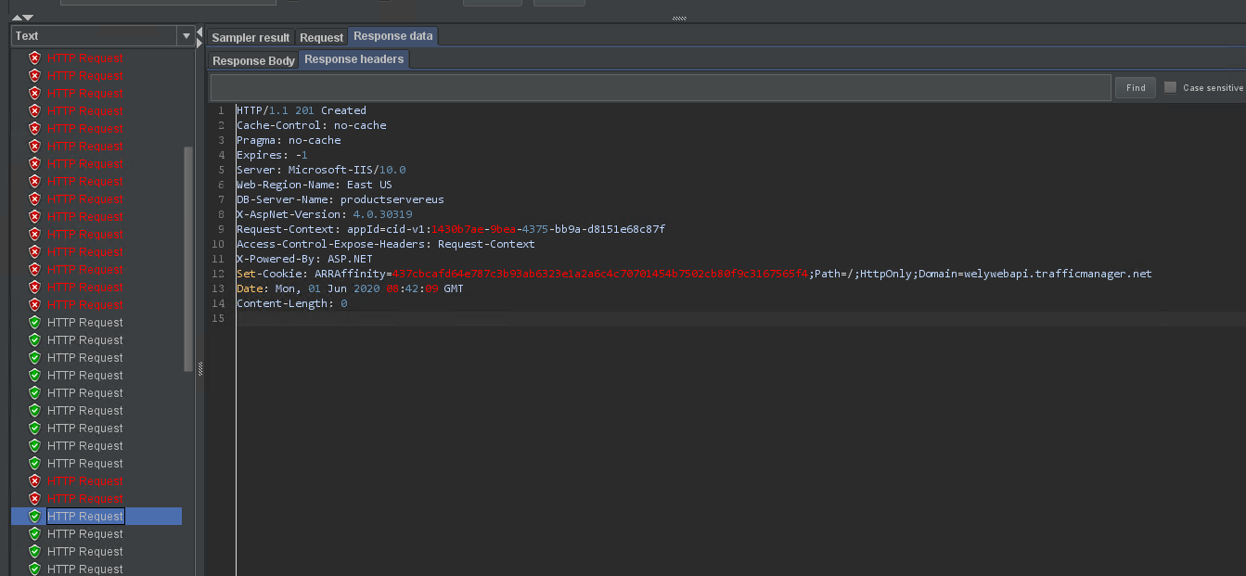
ADD ORDER (POST) 08:40:29 => 08:41:33 = almost 2 min
About 2 minutes recovery time

Slide 46

Scenario 4.2: Region A is down (Email approval)
http://rasd.trafficmanager.net
Bind to my custom domain (http://tm.wely-lau.net)
LB Method: Priority
Entire region A is down (including Web A and DB A)
TM will route all the traffic to Web B.
Because DB A is also down, we need to trigger the failover of the database to DB B.
TM allows us to emit a set of diagnostic log to EventHub, including the status of the endpoint which we’d need here.
We then use Stream Analytic to query the log containing Status = “Down” and then invoke an Azure Function to send email approval to admin.
Admin will need to click the link to initiate the failover
Client
Endpoint | Priority | Status
http://rasdsea.azurewebsites.net | 1 | Online
http://rasdeus.azurewebsites.net | 2 | Online
Send an email to admin
Web A: rasdsea.azurewebsites.net
DB A: rasdeus.database.windows.net
Region A: Southeast Asia
Web B:
rasdeus.azurewebsites.net
DB B:
rasdeus.database.windows.net
Region B: East US
Failover Group Endpoint:
Send an email to admin
Read Write: group.database.windows.net
Read: group.secondary.database.windows.net

Slide 47
Demo: Scenario 4.2
Entire region A is down; Semi automated (with Email approval)
Notes:
Demo steps:
Go to Azure portal, sql failover group
Start JMeter
Perform Failover on the portal
Checkout the downtime

Slide 48
End of the section

Slide 49
Conclusion
Implement multi-region App Service + SQL Database across Southeast Asia and East US regions
4 different scenario of failover
App + Database Failover takes about 1.5 to 2 minutes
Depends on Traffic Manager Configuration
In my demo: 10 seconds probing interval, 3 tolerated number of failures
Depends on the database size
In my demo: very small, 1 tables, hundreds of records, direct table query, without any fancy joins / logic
Other best practices:
Retry policy / logic on your app, when accessing database

